Slide 1

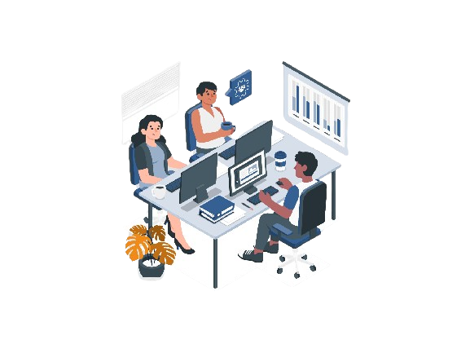
GROUP MEMBERS
Sakshi T
Vaishnavi H
Bhavana M
Priya D
Atharva S
Khusbhu
HR ANALYTICS

Slide 2
INDEX
Introduction
Data overview
KPI analysis, Insights and recommendations
Dashboards of Excel, Power Bi, Tableau, SQL.
Conclusion

Slide 3

INTRODUCTION
Through understanding of the attrition trends.
To identify patterns and potential factors that contribute to attrition.
Potential implications and strategies for addressing attrition.
Building dashboards will elevate simple metrics by linking them to one another and visualizing them as a whole.

Slide 4
DATA OVERVIEW
TOTAL EMPLOYEES
ACTIVE EMP – 25,105
EX EMP – 24,895
50,000
ATTRITION RATE
50.21%
AVG HOURLY INCOME
AVG MONTHLY INCOME
115.43
26015.78

Slide 5
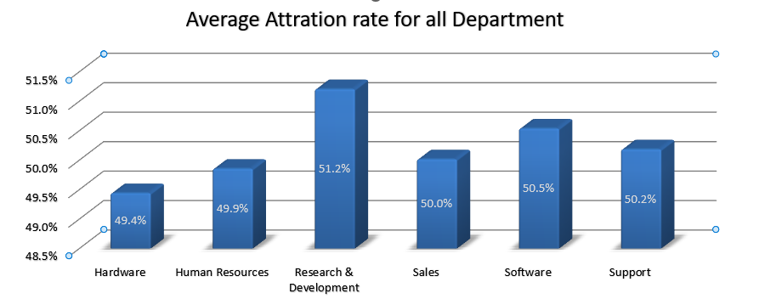
Kpi Analysis, Insights And Recommendation
Average Attrition Rate For All Department
This graph shows the Average attrition rate for all departments.
Research and development department has the highest attrition rate.
Hardware department has the lowest attrition rate.
Evaluate project timeline and resource allocation.
Fix abnormal high overtime hours by hiring and training new workers.

Slide 6
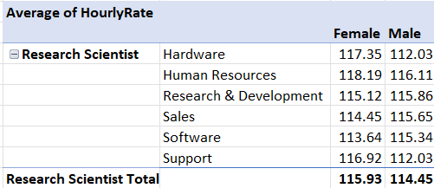
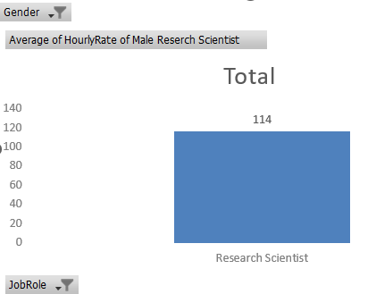
Avg. Hourly Rate Of Male Research Scientist
This Graph shows the average hourly rate of the male research scientist.
Average hourly rate for all department is almost similar.
Male have the lowest hourly rate compare to women.
Less the hourly rate high the attrition rate.

Slide 7
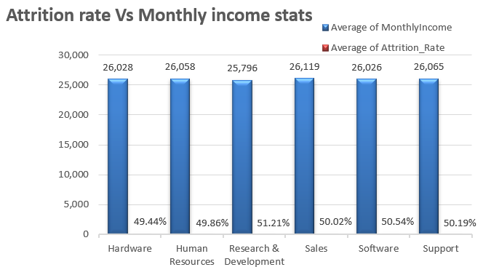
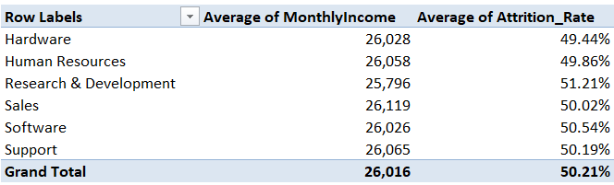
Attrition Rate Vs Monthly Income Stats
This graph shows the attrition rate vs monthly income stats of all the departments.
Attrition rate shows minor variation around 50% across monthly income bins, suggesting balanced turnover with consistent patterns but no clear linear correlation visually depicted in the chart.
Attrition rate exhibit fluctuating but generally stable trends.
Possible reason for attrition include job dissatisfaction, market demand with better offers and potential salary concerns.
Recommendation actions involves salary analysis for competitiveness and implementing retention programs like career development and mentorship.

Slide 8
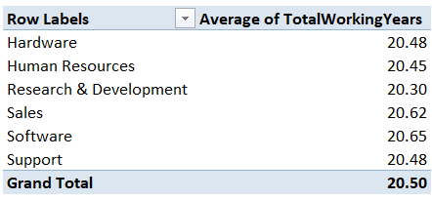
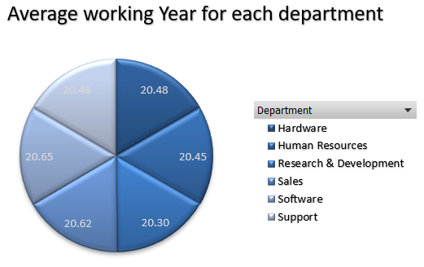
Average Working Year For Each Depatment
Due to rapid growth in salary and rapidly evolving technology younger generation prefer to spend more years in software.
Less people shows ability in the Research and development department.
In sales department, they receive additional commissions for their hard work, as their job involves interacting with the clients.
These differences in working years are also found due to industry trends, company practices and geographic locations.

Slide 9
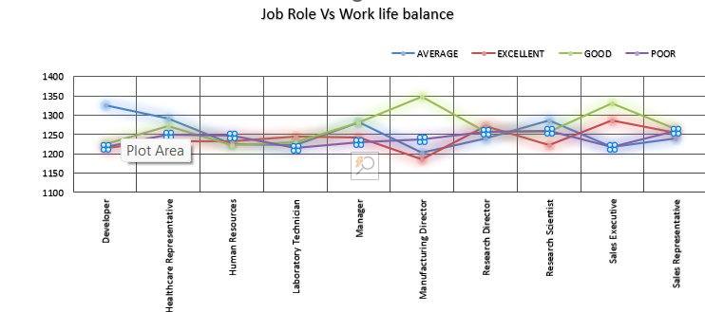
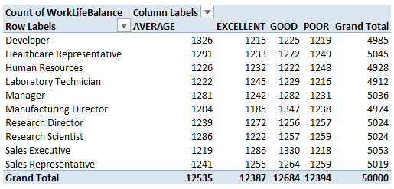
Job Role Vs Work Life Balance
The graph shows the job role verses work life balance.
Work life balance status is average, poor, good and excellent.
As per the chart, the work life balance for all department is approximately same.
The pursuit of a balanced life is not compromise but a strategic investment. It’s a recognition that personal growth. Relationship and rejuvenation are foundational to excelling in any job role.

Slide 10
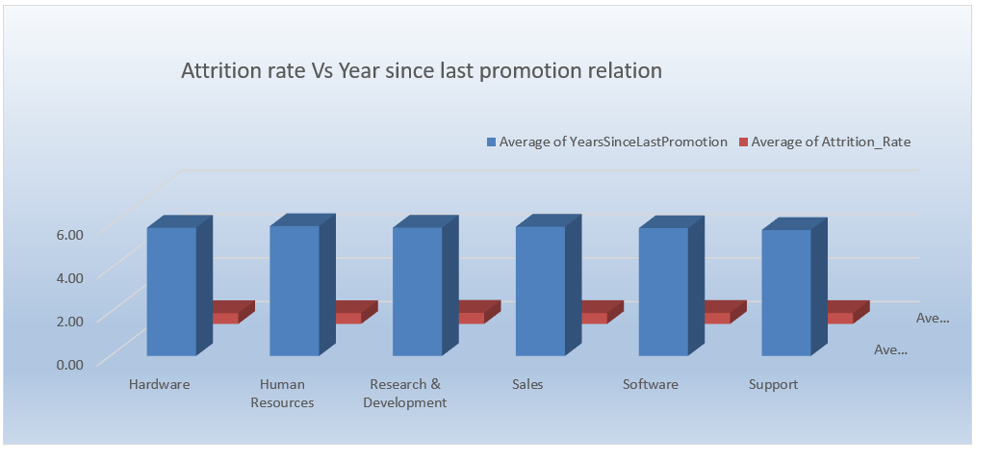
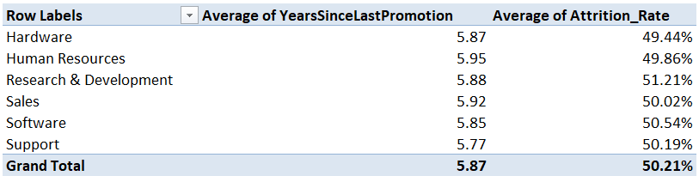
Attrition Rate Vs Year Since Last Promotion Relation
The attrition rate vary within a relatively narrow range from 49.44% to 51.21%.
This suggest that the overall attrition rate is not drastically changing with the years since last promotion.
It might be worth considering other factors that could influence attrition such as job role, department, monthly income, work life balance and over all job market conditions.

Slide 11
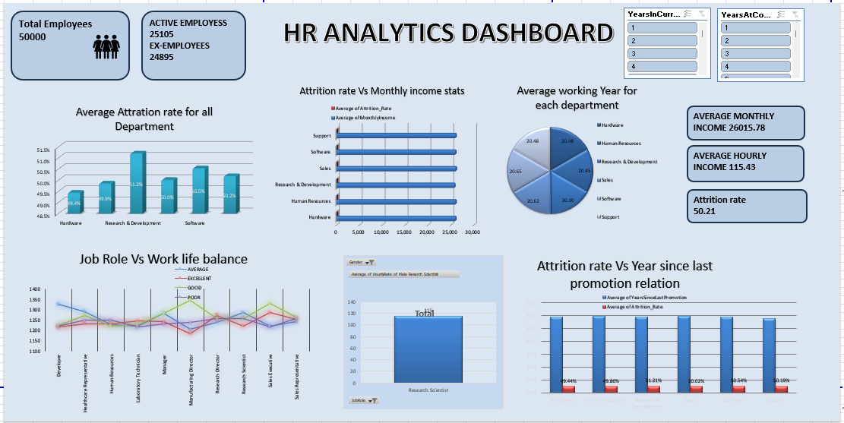
Excel dashboard

Slide 12
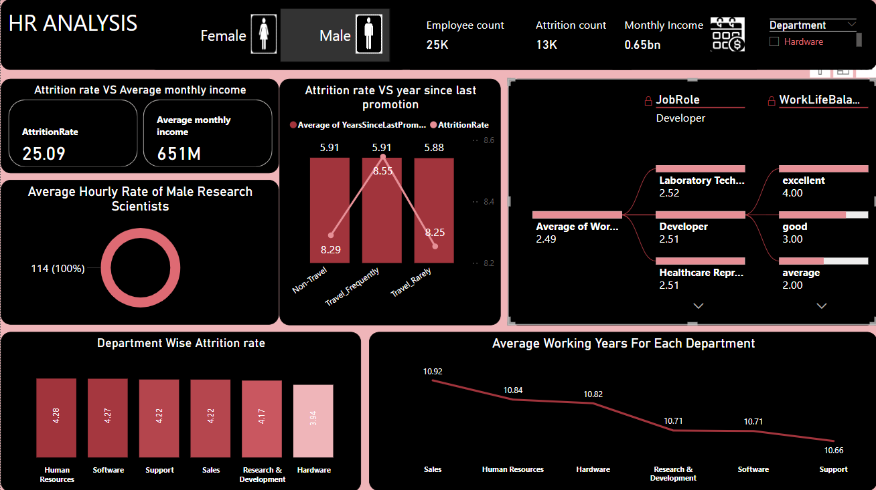
Power Bi dashboard

Slide 13
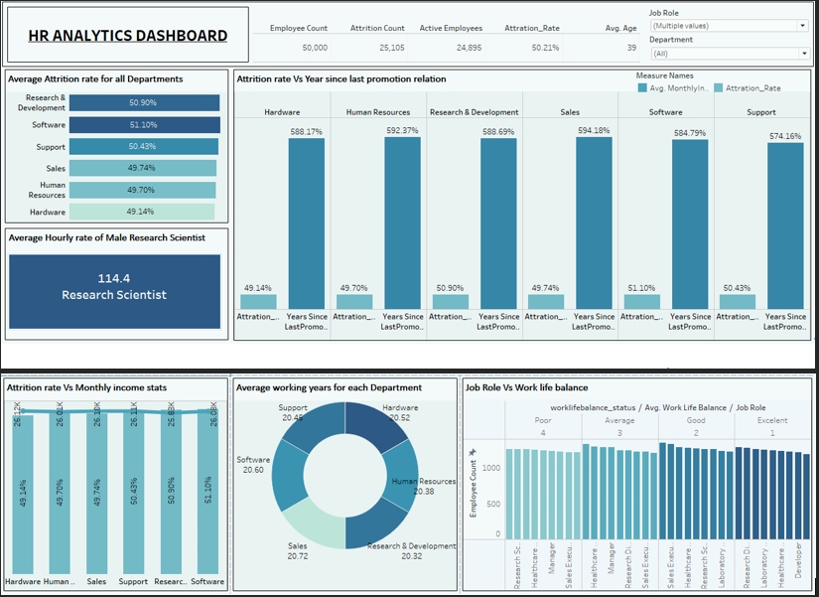
Tableau Dashboard

Slide 14
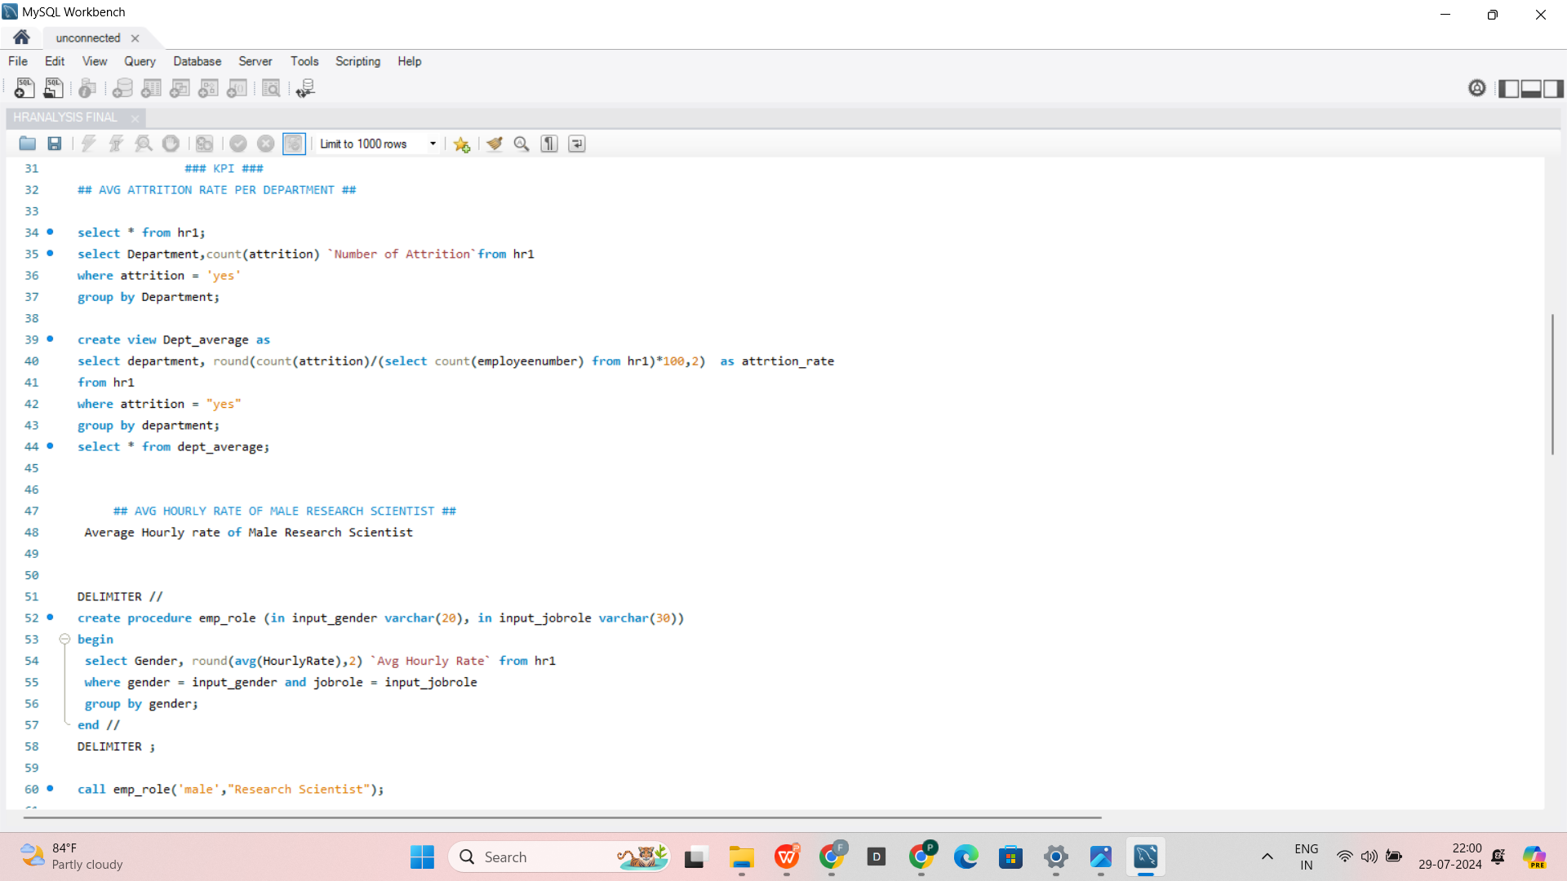
SQL

Slide 15
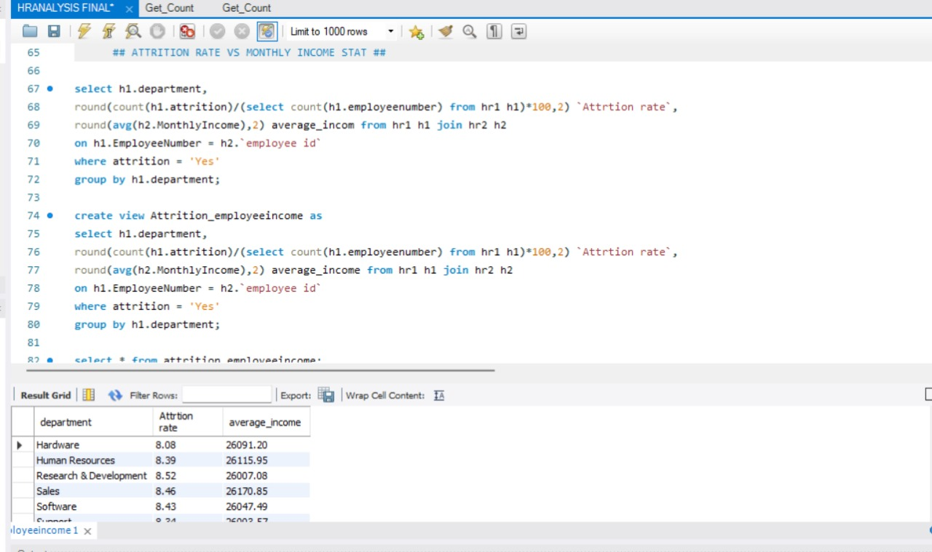
SQL

Slide 16
Conclusion
The HR Analytics Dashboard provides a comprehensive overview of key human resource metrics. It includes data on total employees, attrition rates by gender, department, and age group, average working years by department, and work-life balance status across different job roles. Additionally, it visualizes the relationship between attrition rates and average monthly income, travel distance, and time since the last promotion. This dashboard enables HR professionals to make data-driven decisions to improve employee retention and satisfaction.

Slide 17
THANK YOU

